Slide 1
Pub Quiz Iași
UNIVERSITATEA "ALEXANDRU IOAN CUZA" IAȘI
FACULTATEA DE INFORMATICĂ
Scientific coordinator
Olariu Florin
Author
Duca Alexandru

Slide 2
Table of contents
01
02
03
04
06
Introduction
Tech stack
User features
Context and the proposed solution
Architecture and technologies
Demo of our user's features
Admin features
05
Conclusions
Future directions
Demo of our admin's features
What we achieved
What we plan to do next

Slide 3
01
Introduction

Slide 4
Introduction
Context
Solution
The need of digitization
Potential for growth
Elimination of dependence on other platforms
A web application that defines the event's identity
All resources are located within the same location

Slide 5
02
Tech stack

Slide 6
The Three-Tier Architecture
Presentation
Application
Data
React with TypeScript
Redux
Redux Toolkit
Redux Saga
i18n
React Router
Material-UI
Node.js with TypeScript
Express
Mongoose ODM
JWT tokens
Three layers: Controllers, Models, Routes
MongoDB

Slide 7
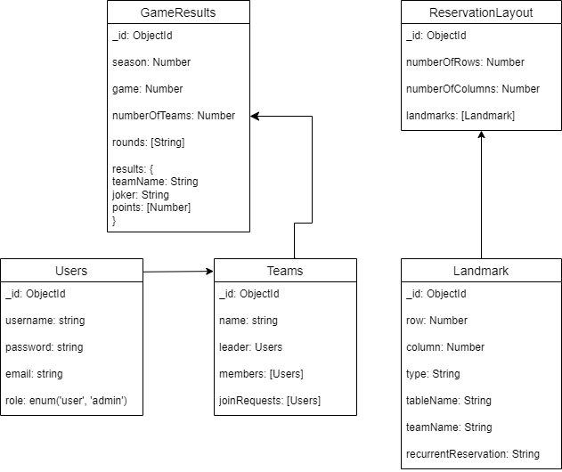

Slide 8
03
User features

Slide 9
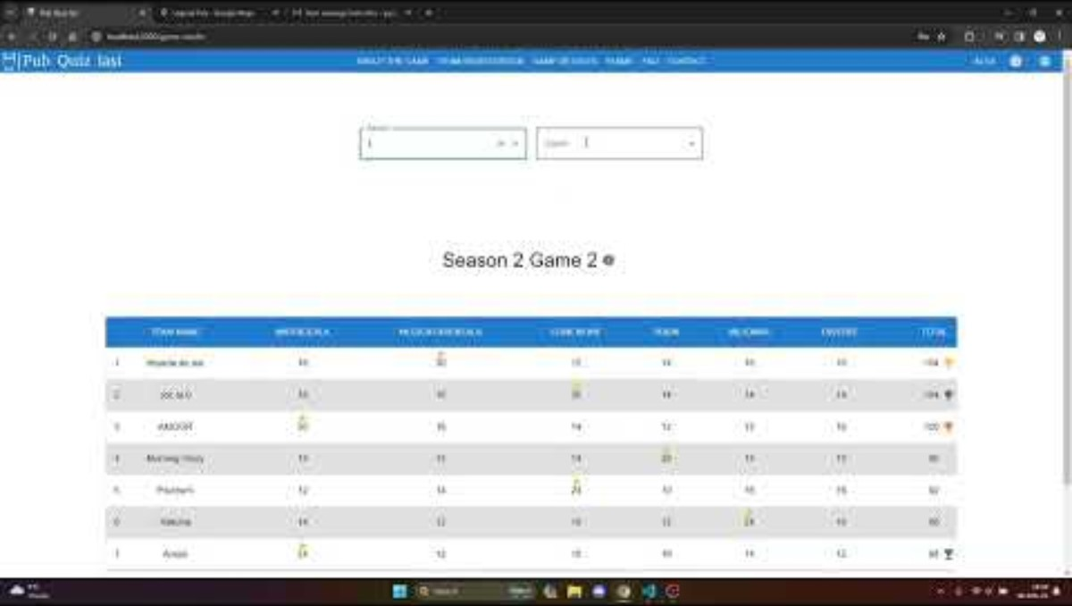
Demo

Slide 10
04
Admin features

Slide 11
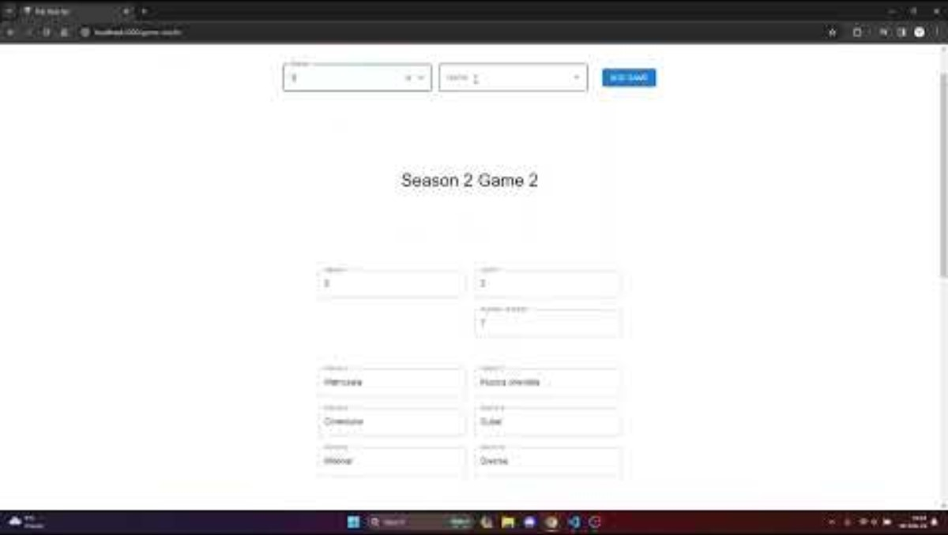
Demo

Slide 12
05
Conclusions

Slide 13
Conclusions
With a variety of features for users and organizers, the Pub Quiz Iasi application effectively advances the digitization of the physical Quiz Iasi event.
We made sure that all the functionalities the event depends on are implemented within the application.

Slide 14
06
Future directions

Slide 15
Future directions
These are a few key functionalities we intend to focus on:
Increase the social aspect of our application
Add a chat section for each team
Make it possible to host online games
A chat bot to help users to get familiar with the features

Slide 16
Thank you!

